Slide 1


Q&A System
This platform enables users to ask questions and receive textual answers. It is designed to faster learning, collaboration, and knowledge discovery. It streamlines information access, analyzes user sentiment, and enables feedback.
Meet Our Team (Group 2):
- Nekkala Sumanth Naidu [23CS8111]
- Narreddy Balaiahgari Sai Keerthana [23CS8112]
- Ganapathri Praphul Chandra [23CS8113]
- Authy Saha [23CS8114]
- Tanusha Pramanik [23CS8115]
- Suryam Kumar Gautam [23CS8116]
- Sumit Kumar [23CS8117]
- Anurag Prasad [118]
- Gavirni Venkata Satya Krishna Chaitanya [23CS8119]
- Yaraveda Govardhan Reddy [23CS8120]

Slide 2

02
Q&A System
Problem Description
• Develop a Q&A system platform where questions can be posted and answers (textual) may be received.
Primary Objectives:
• Enable basic search on the Q&A archive
• Analyze sentiment of an answer
• Assign credits/ratings to registered members
• Use of the platform for receiving class feedback
Secondary Objectives:
• Enables users to log in from different terminals from different physical machines
• Enables Manager/User registration and authentication (using some hash-based password)
• A user-friendly text interface
• A multithreaded platform

Slide 3





System Workflow
> Search Questions → Retrieve from File
> Post Question → Store in File & Notify Users
> Submit Class Feedback → Store Anonymously
> Sentiment based on no. of good and bad words
> If New User → Register & Hash Password
> If Existing User → Authenticate
> Answer a Question → Store Answer in File
> Upvote/Downvote Answer → Update Vote Count

Slide 4

Client-Server Interaction
Client connects to the server via sockets.
User logs in (or registers) and gets authenticated.
Client posts questions, which are stored on the server.
Other clients submit answers, and sentiment analysis runs.
Users vote on answers, updating scores.
Clients can disconnect, and the server ensures a smooth shutdown.
Data is stored persistently in files with proper synchronization.
Multithreading handles multiple users in real-time.
Clients request/search for questions & answers.

Slide 5
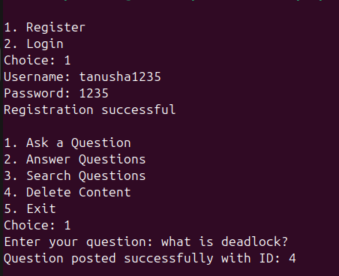
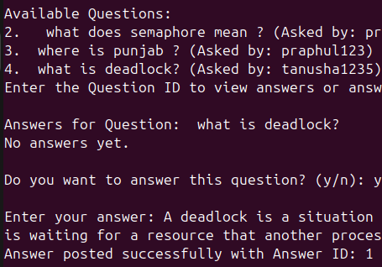

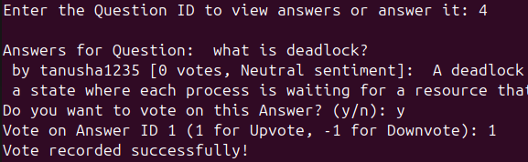
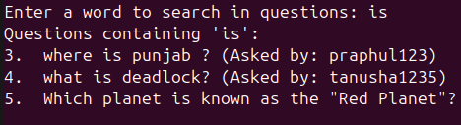
Text-Interface for Easy Understanding
1.registration
2. posting question and ans
3.answering que and giving feekback on ans
4.searching posted que

Slide 6
System Architecture
Question
-string questionID;
- string userID;
- string text;
+void display()
+string getID() { return questionID; }
User
Answer
QASystem
-string userID;
-string username;
-string passwordHash;
-int reputation;
+bool authenticate(string inputHash)
+void updateReputation(int change)
+void display()
+string getID()
+int getReputation()
-string answerID;
-string questionID;
-string userID;
-string text;
-int upvotes;
-int downvotes;
-int sentimentScore;
+void upvote() { upvotes++; }
+void downvote() { downvotes++; }
+ void setSentimentScore(int score)
+int getFinalScore()
+void display()
- map<string, User> users;
- map<string, Question> questions;
- map<string, Answer> answers;
- SentimentAnalyzer sentimentAnalyzer;
+ void registerUser(string id, string name, string hash)
+ bool login(string id, string hash)
+ void postQuestion(string qID, string uID, string text)
+ void postAnswer(string aID, string qID, string uID, string text)
+ void voteAnswer(string aID, bool isUpvote)
+ void displayQuestions()
+ void displayAnswers(string qID)
SentimentAnalyzer
-unordered_set<string> positiveWords= {"good", "great", "helpful", "informative", "excellent"};
- unordered_set<string> negativeWords = {"bad", "misleading", "incorrect", "poor", "confusing"};
+ int analyze(string answerText)

Slide 7
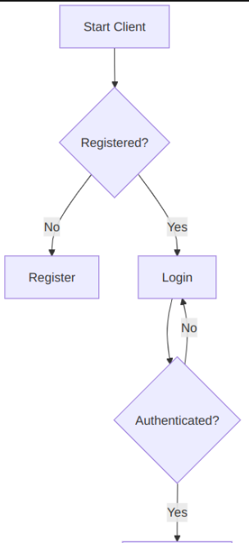
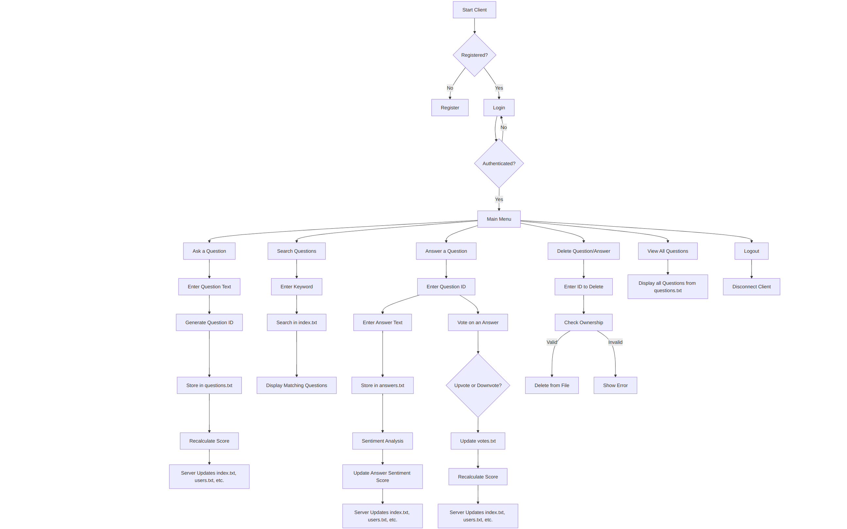
System WorkFlow

Slide 8
System Modular Design
Client Component (client.cpp):
main(): Entry point that initializes UI and establishes server connection
connectToServer(): Creates and configures socket connection to the server
handleUserAuthentication(): Manages user login/registration processes
displayMenu(): Renders the main options menu for user interaction
sendQuery(): Formats and transmits user questions/searches to the server
displayResults(): Presents search results or question answers to the user
Server Component (server.cpp):
main(): Entry point that initializes server socket, database, and begins listening
acceptConnections(): Monitors for and accepts new client connection requests
handleClientRequest(): Processes incoming client requests and sends responses
initializeDatabase(): Loads stored data from files into memory on startup
shutdownServer(): Performs clean shutdown with data saving and connection closing
Answer Management (Answer.cpp):
Answer::Answer(): Constructor that initializes a new answer with content and metadata
Answer::getVoteCount(): Calculates and returns the current vote total
Answer::addVote(): Records a new user vote (up/down) for the answer
Answer::serialize(): Converts answer data to string format for file storage
Answer::deserialize(): Reconstructs answer object from stored string data

Slide 9
Question Management (Question.cpp)
Question::Question(): Constructor that creates a question with title and content
Question::addAnswer(): Associates a new answer with this question
Question::getAnswers(): Retrieves all answers linked to this question
Question::serialize(): Converts question data to string format for storage
Question::deserialize(): Reconstructs question object from stored string data
Question::search(): Determines if the question matches given search criteria
Database Management (
DatabaseManager::loadData(): Reads all data files and loads content into memory
DatabaseManager::saveData(): Persists updated data back to storage files
DatabaseManager::addQuestion(): Stores a new question in the database
DatabaseManager::addAnswer(): Stores a new answer in the database
DatabaseManager::getQuestion(): Retrieves specific question by its identifier
DatabaseManager::searchQuestions(): Finds all questions matching search parameters
DatabaseManager::updateVotes(): Updates stored vote counts for answers
Search Functionality (SearchEngine.cpp)
SearchEngine::parseQuery(): Breaks down search text into processable tokens
SearchEngine::search(): Executes search against the questions database
SearchEngine::rankResults(): Sorts search results by relevance score
SearchEngine::getTopResults(): Returns the most relevant search matches

Slide 10
Content Analysis (SentimentAnalyzer.cpp)
SentimentAnalyzer::analyzeSentiment(): Evaluates the emotional tone of text
SentimentAnalyzer::detectToxicContent(): Identifies potentially inappropriate content
SentimentAnalyzer::getSentimentScore(): Calculates numerical sentiment rating
Thread Management (ThreadManager.cpp)
ThreadManager::createThread(): Spawns new thread for handling client connectionThreadManager::joinThreads(): Synchronizes by waiting for thread completion
ThreadManager::acquireLock(): Obtains mutex lock for safe resource access
ThreadManager::releaseLock(): Releases mutex lock after resource use
ThreadManager::initializeThreadPool(): Creates thread pool for connection handling
User Management (User.cpp)
User::User(): Constructor that initializes user with credentials and profile
User::authenticate(): Verifies provided login credentials against stored data
User::getReputation(): Calculates and returns user's current reputation score
User::addQuestion(): Associates a posted question with the user's account
User::addAnswer(): Associates a posted answer with the user's account
Helper Utilities (Utility.cpp)
Utility::getCurrentTime(): Generates formatted timestamp for system operations
Utility::hashPassword(): Creates secure one-way hash of user passwords
Utility::splitString(): Parses strings into tokens using specified delimiter
Utility::generateUniqueID(): Creates unique identifiers for system entities

Slide 11

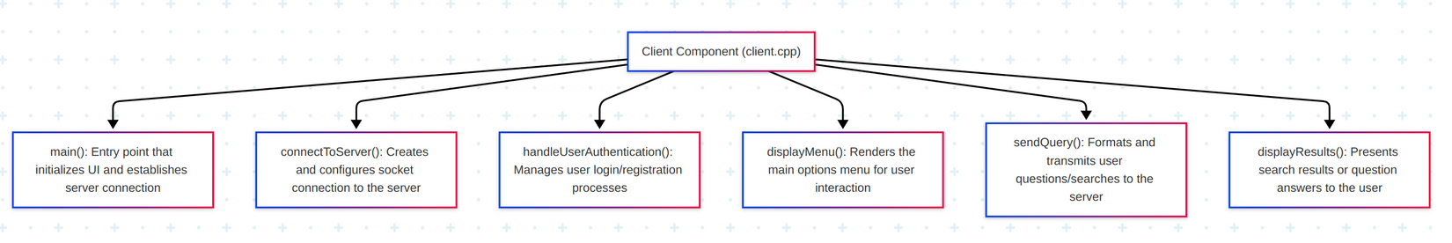
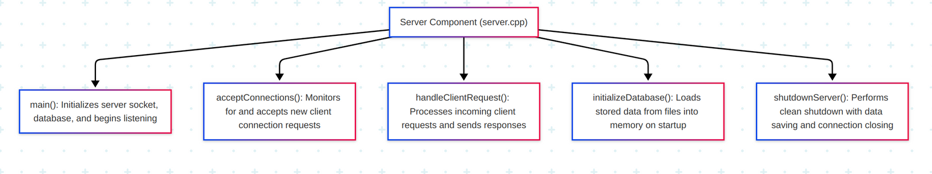
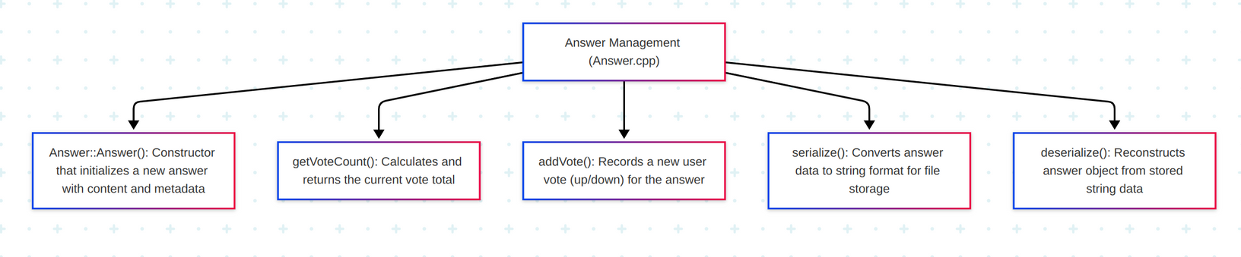
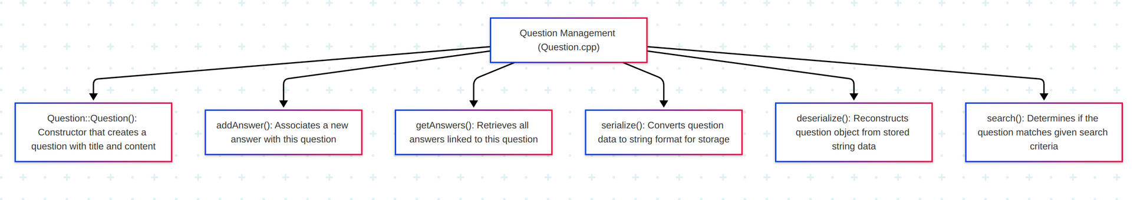
Modular Level Design

Slide 12
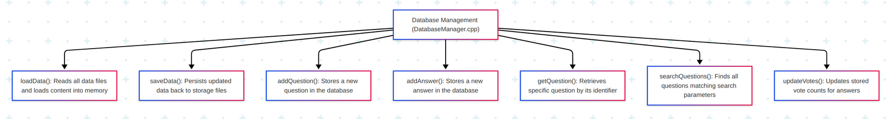
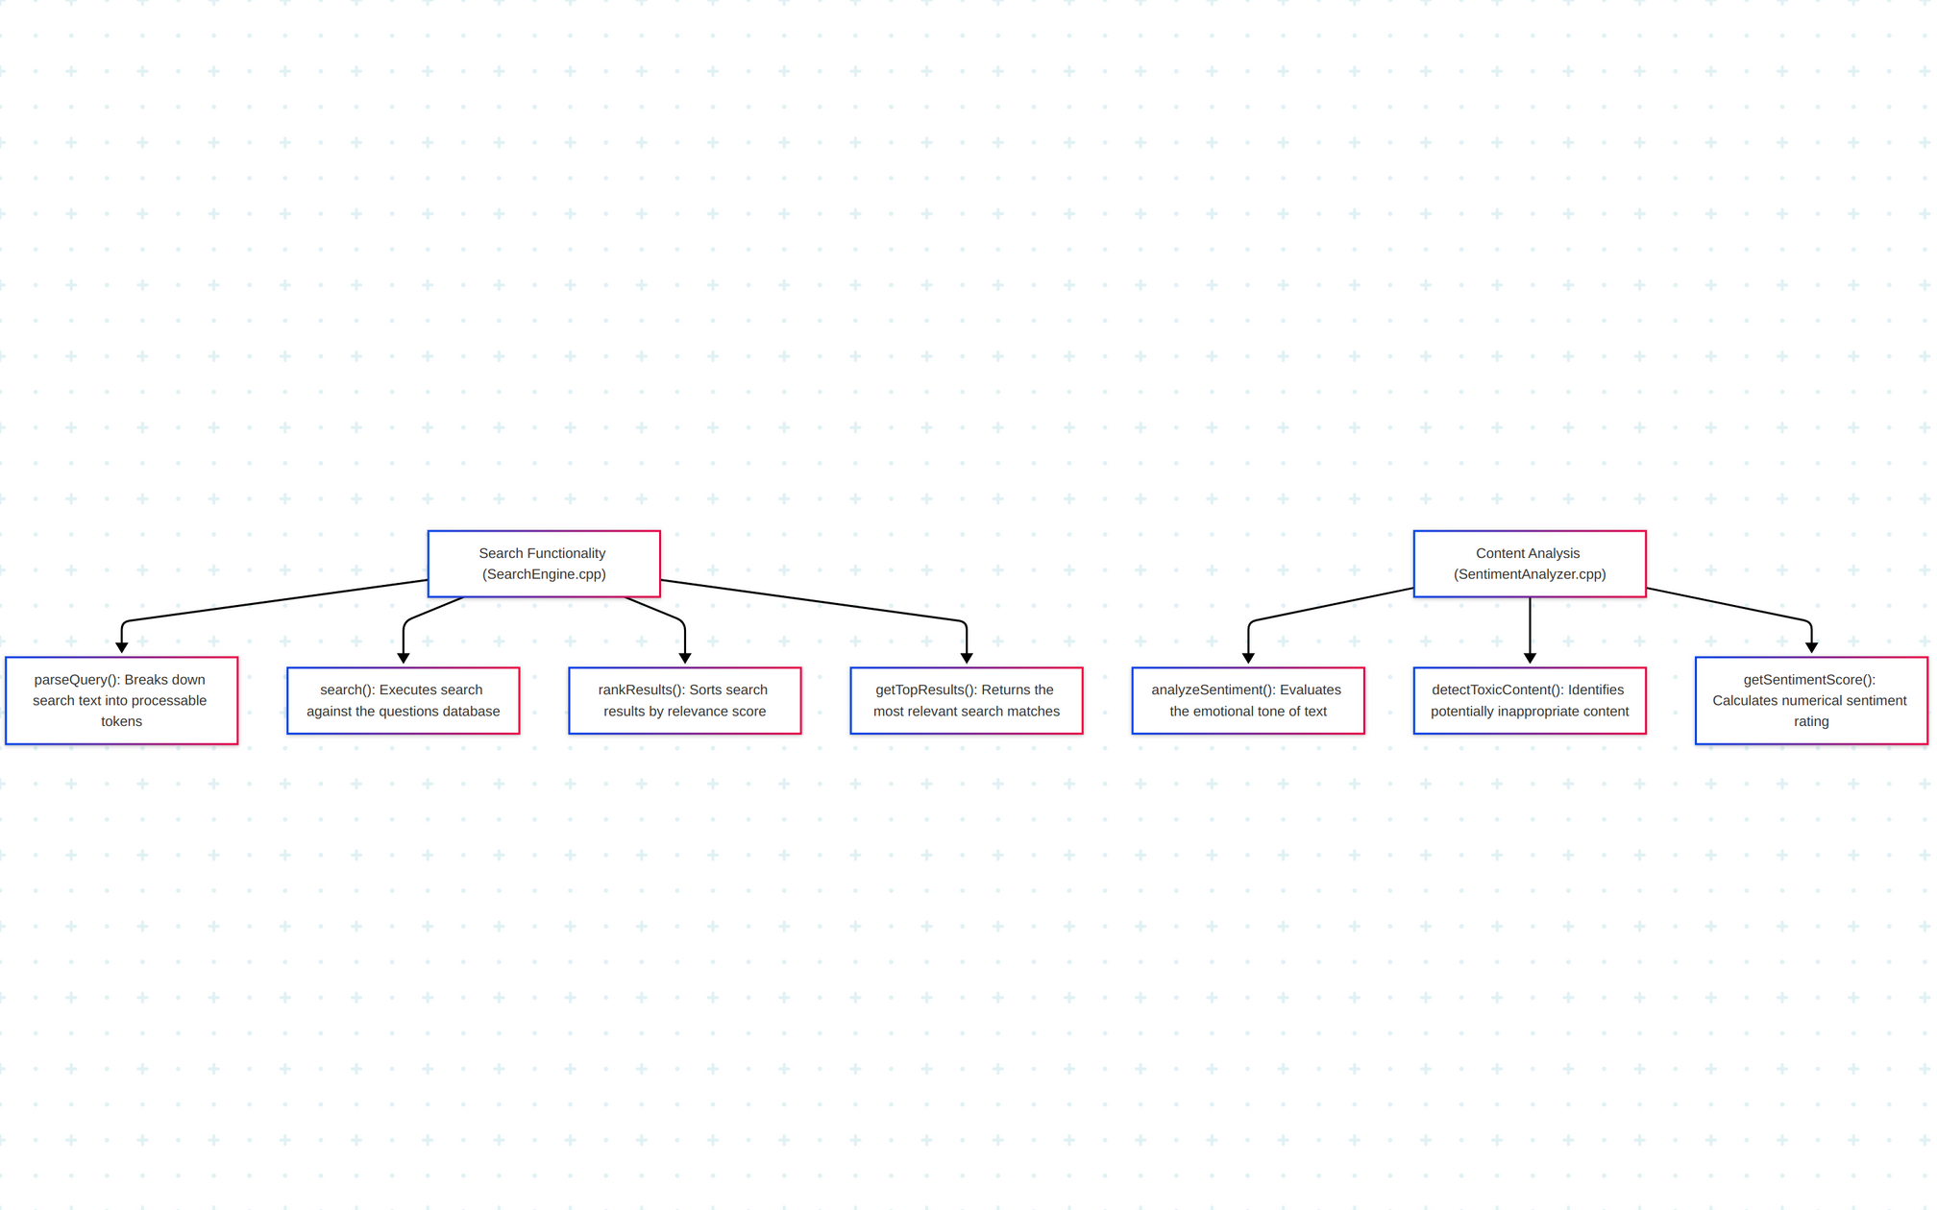
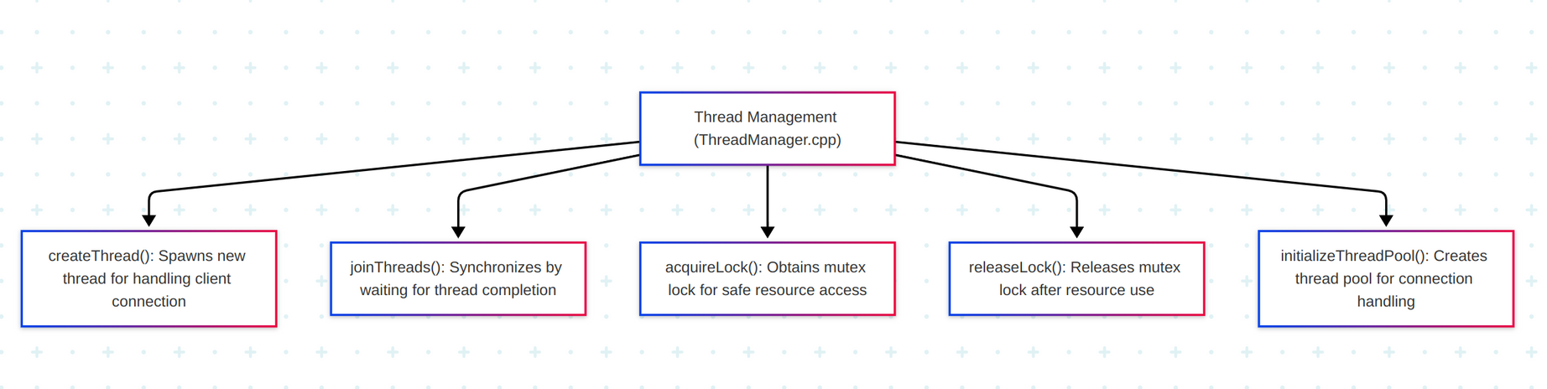
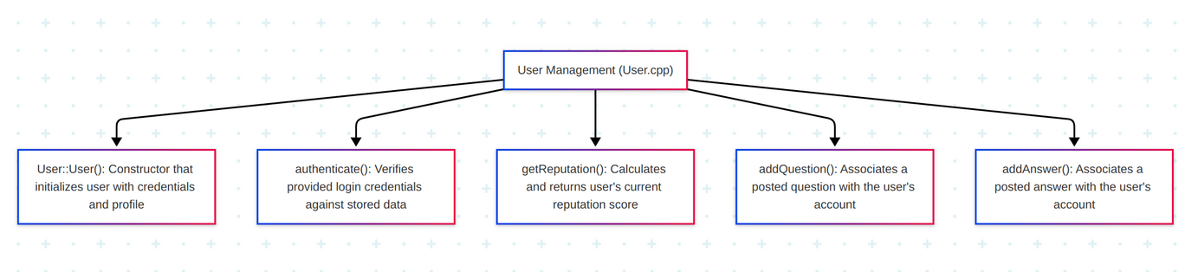
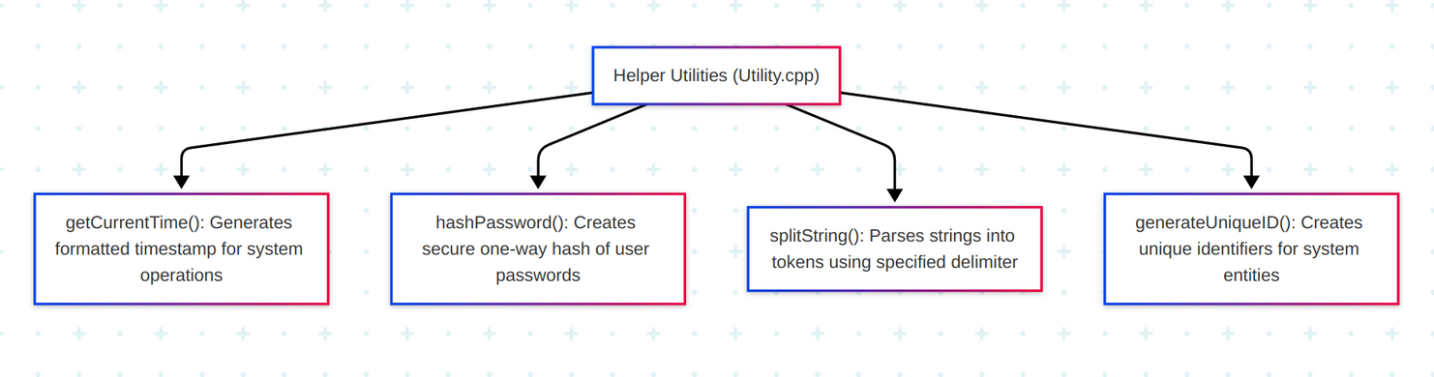

Slide 13
Features
01
02
03
Multithreading
Sockets
Shared Memory
Enables concurrent user interactions.
Allows real-time multi-user access.
Speeds up frequently accessed data.
04
05
06
Signals
Files & File Locking
Semaphores
Manages clean shutdown and process control.
Provides persistent storage with safe access.
Synchronizes shared resource access.

Slide 14

Features
Delete Question or Answer
User authentication
Ask Questions
Voting
Sentiment Analysis
Answer existing Questions
Searching questions by Word index

Slide 15

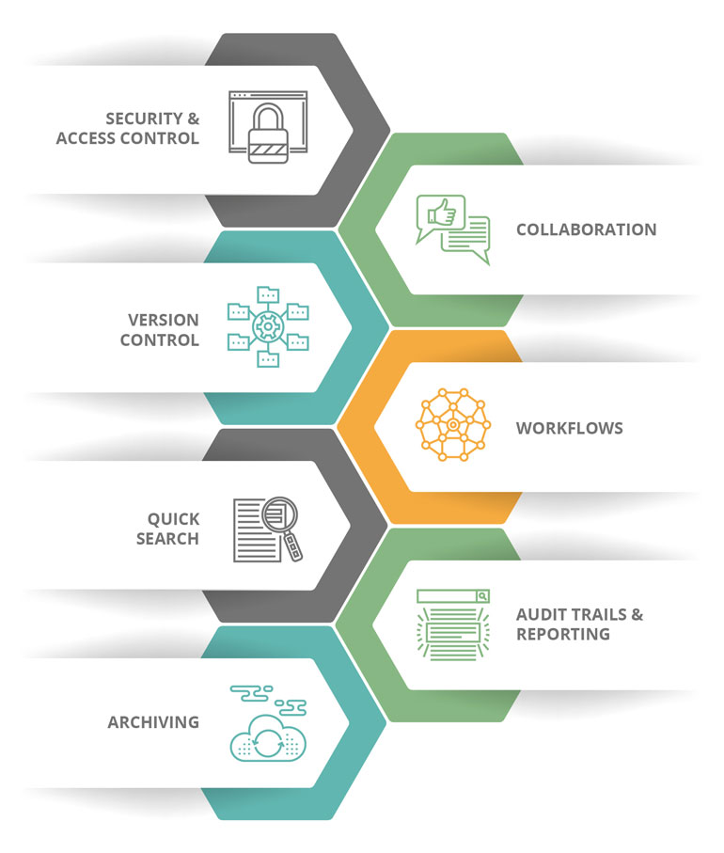
Application Level Features
USER AUTHENTICATION
USER RATING
REAL-TIME UPDATES
EASY NETWORKING
SEARCH QUESTIONS
INTERACTIVE USER INTERFACE
STORAGE THROUGH FILE SYSTEMS

Slide 16

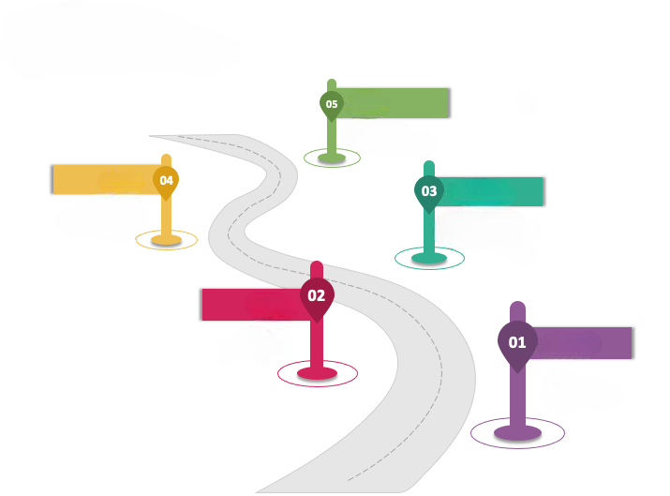
Timeline Goals
Finalize a stand-alone
version of the project
Code review with
user feedback.
First round of code
completion and review
create a basic layout/structure of project
Final draft of ppt
and UI planning

Slide 17


Future Additions
User password hashing
A web Interface for better usability
Comments section
user password right now is not hashed, but would hash if further time allows
Upgrading the user interface from text-based interface to Web interface for better usability of the user
further addition of the comments section for the user to comment on the answer if the answer is right or wrong.
Over the Network
communication
Make over the network communication possible, so that a user from another device can access the server and do real-time udpates

Slide 18

PROJECT RESPONSIBILITIES
01 | System Design | Anurag Prasad Sumanth Naidu Praphul Chandra
02 | Project Planning | Tanusha Pramanik Chaitanya
03 | Coding | Anurag Prasad Praphul Chandra
04 | PPT Design | Govardhan Reddy Chaitanya Praphul Chandra
05 | UI Interfacing | Sumit Suryam Gautam Govardhan Reddy
06 | Resource Management | Keerthana Authy saha Praphul Chandra

Slide 19


THANK YOU
- By GROUP 2

